Slide 1
Lecture 1
Introduction to Application Oriented Networking

Slide 2
TODAY’S AGENDA
Introduction to Application Oriented Networking
History of Internet (Kleinrock)
Internetworking
Internetworking

Slide 3
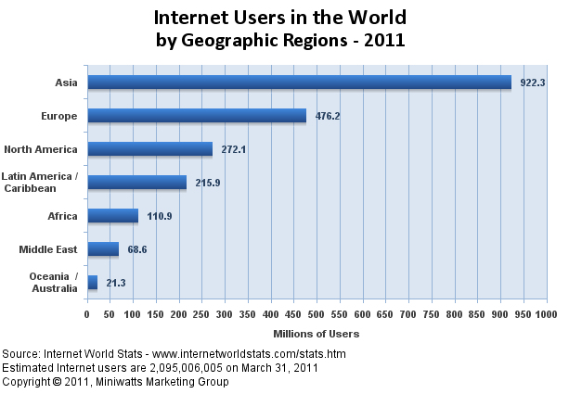
Scale of Internet
Number of users:

Slide 4


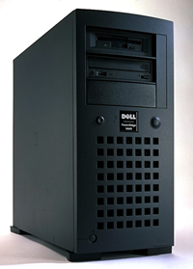
Database
Multimedia & Transcoding
Virus and Malware
INTERNET
Computer Games
Wireless
Telephone
E Mail
FTP

Slide 5



INTERNET APPLICATIONS - SECURITY
INTERNET

Slide 6


INTERNET
We must protect the Internet by adding more intelligence. Well, why not provide some additional service and make some money too!

Slide 7
Firewall: Rules to accept, deny (drop) or reject (drop with notification to sender) packets
Application
gateway
Packet
filtering
routers
Home/Corporate
network
Connections
to outside
world
Security
perimeter

Slide 8
Deep Packet Inspection (DPI): L7 Filter
Target:
Packet Inspection where protocol ID is not available in the packet header. Inspect the payload to determine.
Major Challenge
Computationally expensive involving packet matching algorithms
Current optimizations
Software: Regular Expression (RE) representation
Hardware: ASICs
We have done extensive research in developing multithreaded L7 filter algorithms and scheduling them on multicore processors

Slide 9

VoIP gateways
Tasks: QoS, Variable Frame Sizing, Voice Processing, etc.
VoIP gateway
VoIP gateway
IP
QoS WAN
IP
QoS WAN
pcm
pcm
PSTN
PSTN
Public Switched
Telephone Network

Slide 10
Multimedia Transcoding
Two important requirements
If the receiver is not capable of interpreting the stored data Ex: wireless receivers, hand-held devices, etc.
Store different versions of videos in the server
Compression for bandwidth and storage efficiency
Corporate Network
Video-on-demand server
Mpeg encoder
Transcoder
Internet
Media Player

Slide 11
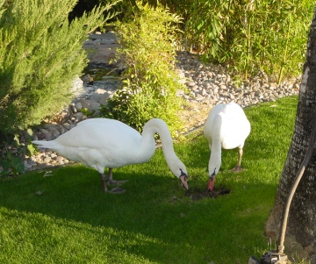

A Multimedia Active Router in the Network
Passive Router
Active Router
Passive Router
Media Server
A large number of clients, Heterogeneity in clients’ inbound network bandwidth, CPU/MEM capacity or display resolution
Reliability and bandwidth of the network
Why not convert the video in the router as per the client requirent?
Courtesy “A Cluster-based Active Router Architecture”, G. Welling, et al. IEEE Micro, January/February 2001.

Slide 12
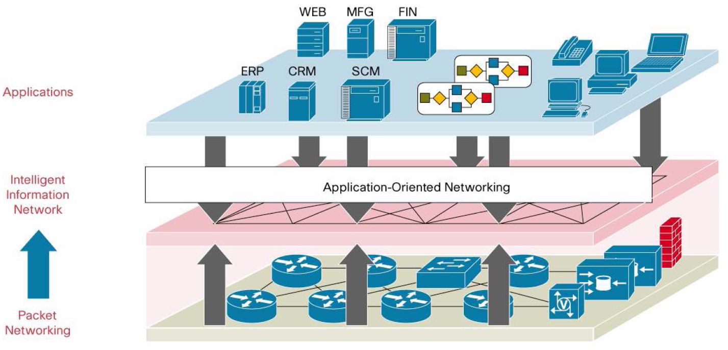
Let the network speak the language of applications! – Vertical processing – A change in networking paradigm
Courtesy: http://www.cisco.com/en/US/products/ps6438/products_white_paper0900aecd8033e9a4.shtml

Slide 13
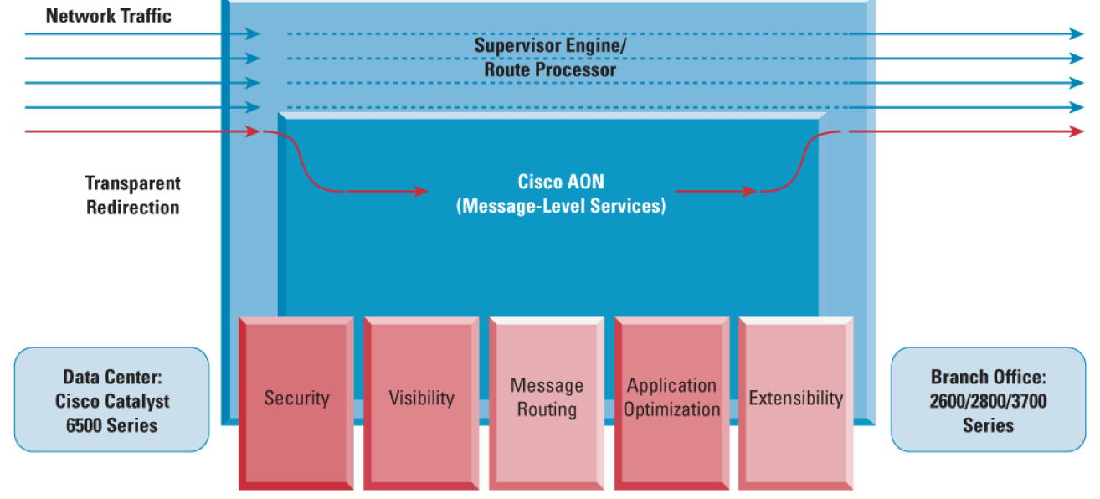
Redirecting Traffic to Cisco AON Module

Slide 14
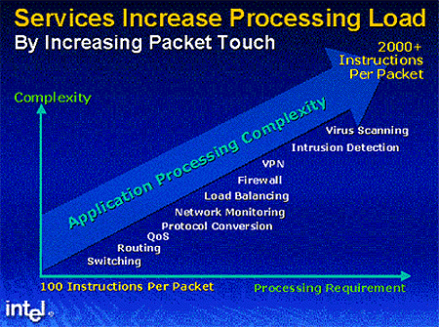

Slide 15
Network I/O Processing
1000
TCP requirements Rule of thumb:
1GHz for 1Gbps
100
100
Network bandwidth outpaces Moore’s Law
40
10
10
GHz and Gbps
1
0.1
Moore’s Law
.01
1990
1995
2000
2003
2005
2006/7
2010
Time

Slide 16
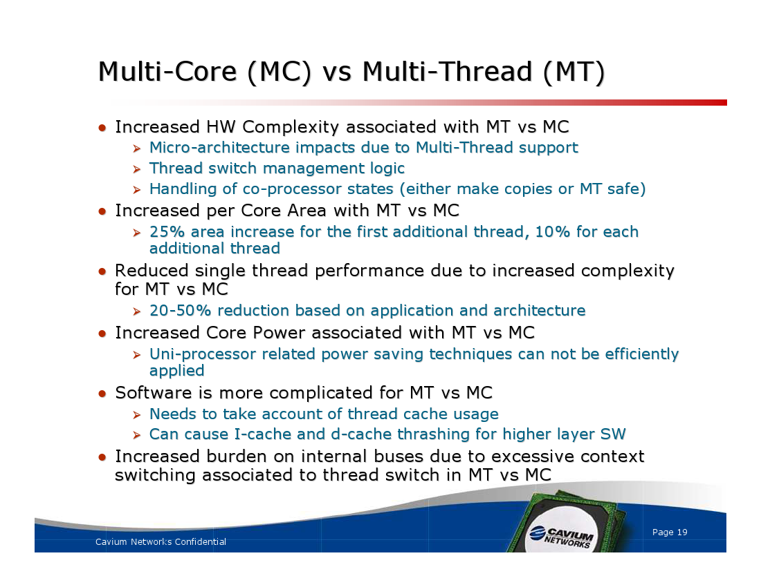

Slide 17
AON Scheduling Problem
How to increase throughput? – Adaptive Scheduling and Load Balancing techniques
Messages may have real-time constraints – Latency in addition to throughput => Need good old parallel processing
Not enough code memory in network processors (Ex. IXP 2800) => Need pipelining
How about QoS – Jitter and Out-of-Order departure of packets?
Kind of Similar to old Cluster Computing! => Must schedule messages and balance load to increase throughput and reduce latency, but we never considered throughput or pipeline.

Slide 18
Problem Statement
Scheduling/Load balancing to boost throughput, reduce latency and improve QoS
Scheduling must consider Connection Locality between packets in addition to load balancing
Multicore processors – Cache locality (Intel Xeon) and Thread locality (Sun Niagra)
Parallel and Pipeline scheduling to maximize throughput and minimize response time given code memory size, and real-time constraint, etc
How about scheduling for power and energy conservation?

Slide 19
Networking has many facets
Goals: functionality, scalability, throughput performance, security, power efficiency, manageability, etc.

Slide 20
Structuring networks and protocols
Goal of network:
Provide communication for distributed applications
How to organize networks in such a way that they
Work correctly?
Are scalable to large number of nodes?
Can achieve high performance?
Are interoperable across different technologies and uses?

Slide 21
Example network
How to achieve end-to-end data exchange?

Slide 22
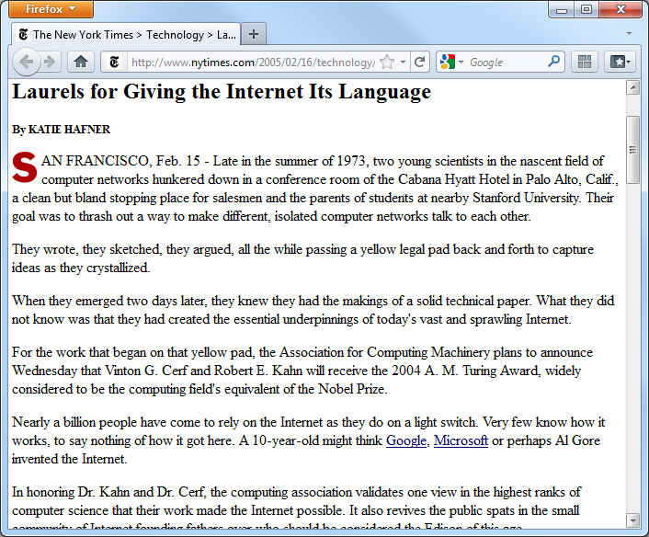
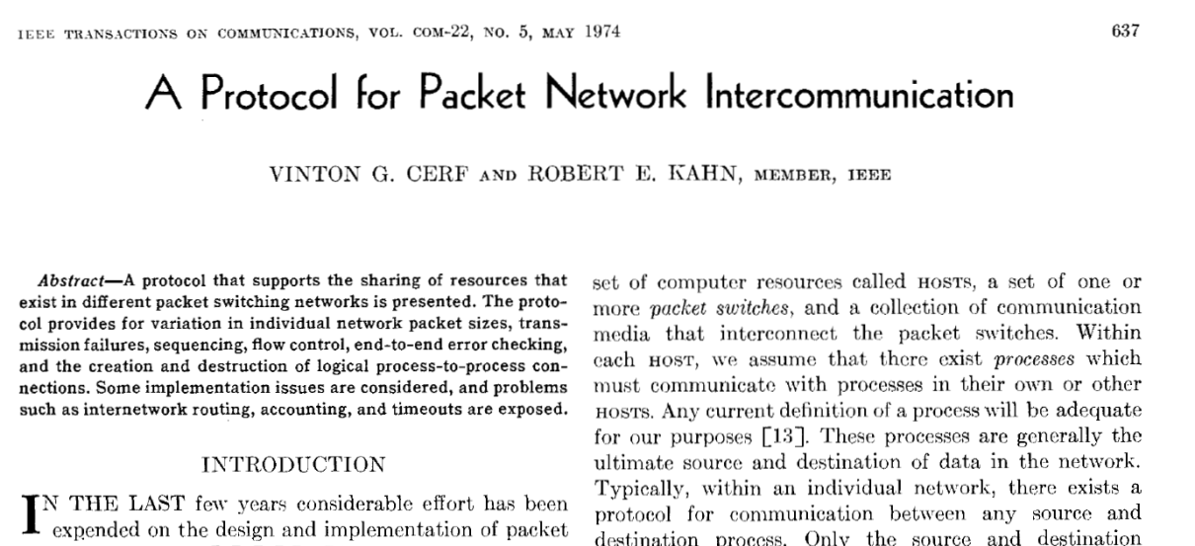
Internet architecture
Designing the structure of the Internet was a difficult problem
Many contributions
One example: TCP/IP

Slide 23
Internet architecture
“Hourglass architecture”
Achieves interoperability
Single, common network layer protocol: Internet Protocol (IP)
All network nodes need to support this protocol
Supports diversity
Different link/physical layer protocols below
Different transport/application layer protocols above

Slide 24
Review of specific protocols
We will briefly review three protocols
Link layer: Ethernet
Network layer: Internet Protocol (IP)
Transport layer: Transmission Control Protocol (TCP)
For full details
Networking textbooks
RFCs

Slide 25
Protocols
Protocols define communication between entities
Format and order of messages
Actions taken on transmission and/or receipt of message or other event
Protocols use headers (and trailers) for control information
Naming depends on layer

Slide 26
Process-to-process communication
We have a network. How to get between programs?

Slide 27
Network devices
Network devices differ by highest layer processed
Devices can process/modify headers up to that layer
Switches and routers are most common

Slide 28
Layered Network Architecture (OSI)
Network
B
A
DATA
7
Application
AH
DATA
Application
7
6
Pre.
PH
DATA
Pre.
6
5
Session
SH
DATA
Session
5
4
Transport
TH
DATA
Transport
4
3
Network
NH
DATA
Network
3
2
Data Link
DH
DATA
Data Link
2
1
Physical
PH
DATA
Physical
1

Slide 29
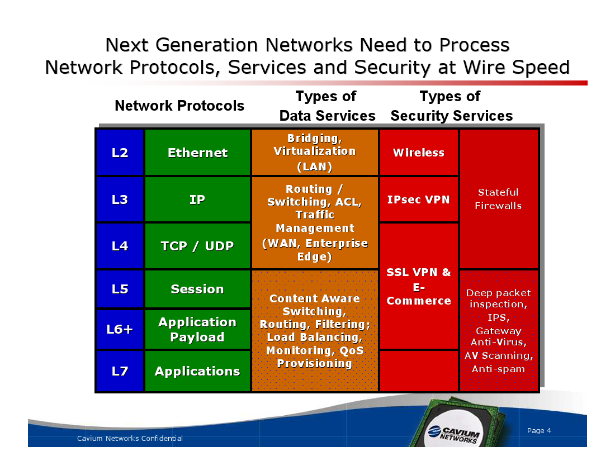

Slide 30
TCP/IP Model
OSI
TCP/IP
7
Application
Application
6
Pre.
5
Session
4
Transport
TCP
3
Network
IP
2
Data Link
Host-to-Net
1
Physical
ISO OSI (Open Systems Interconnection) not fully implemented
Presentation and Session layers not present in TCP/IP

Slide 31
Network systems
How to interconnect ports of the network system?

Slide 32
Routing
Shortest path routing
Centralized approach
Each node has full “view” of network
Each node calculates shortest path using routing algorithm
“Link state algorithm”
(Exchange of link information always decentralized)
Distributed approach
Each node computes best path without full view
Shortest path computed as link information is exchanged
“Distance vector algorithm”

Slide 33
Prefix lookups for packet forwarding
Match of IP destination address with prefixes specified in FIB
Longest matching prefix
Typical core router
Hundreds of thousands of prefixes
Millions of lookups per second
Efficient data structures and algorithms essential for lookup

